Slide 1
Hibernate Overview
Topics
• What is Hibernate? • Beneﬁts of Hibernate • Code Snippets

Slide 2
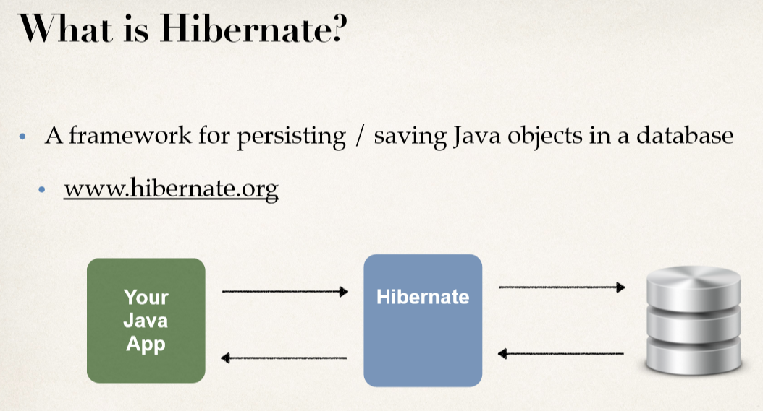

Slide 3
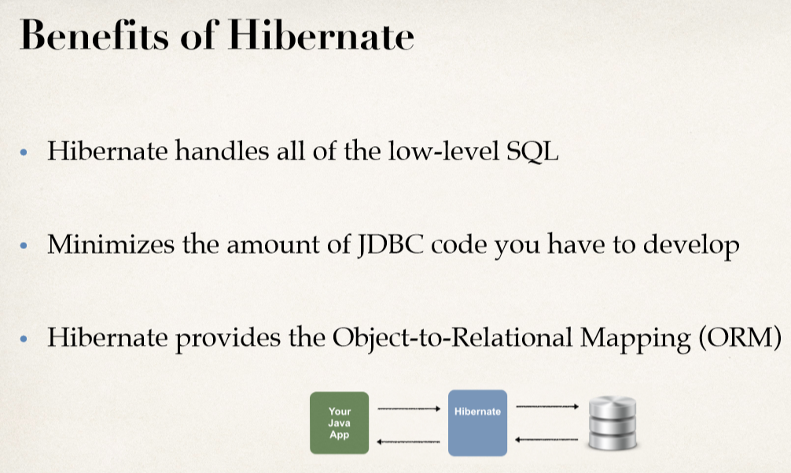

Slide 4
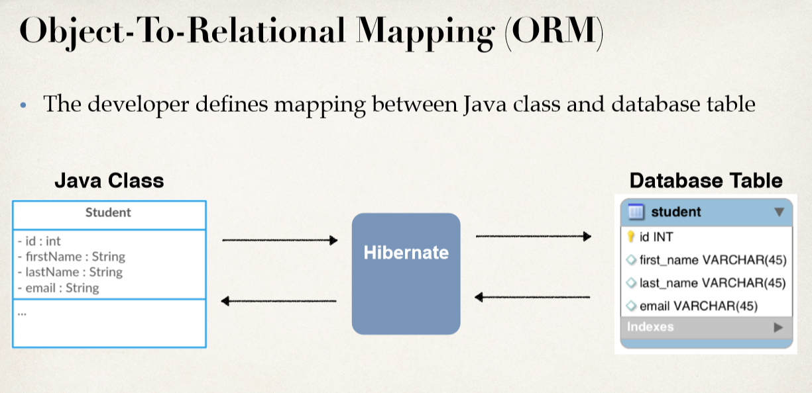

Slide 5
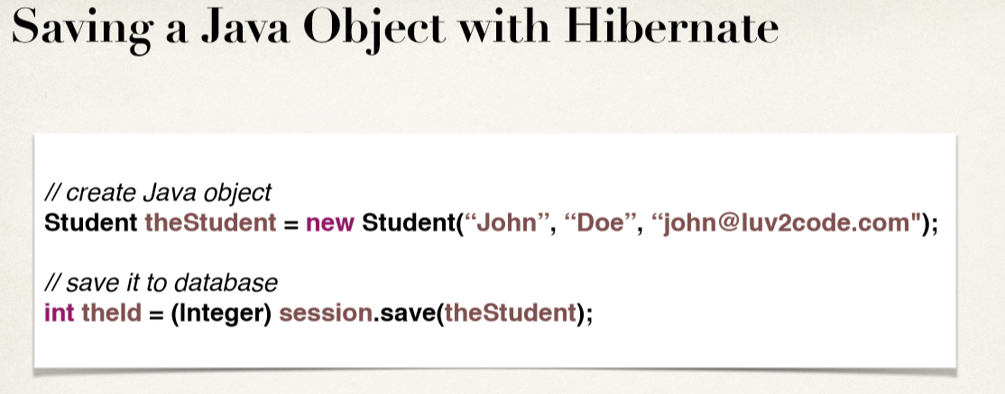
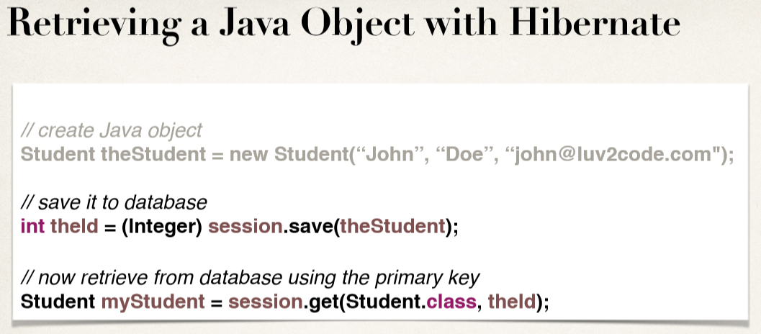

Slide 6
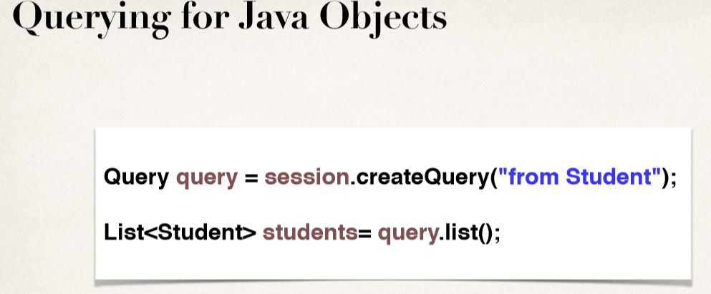

Slide 7
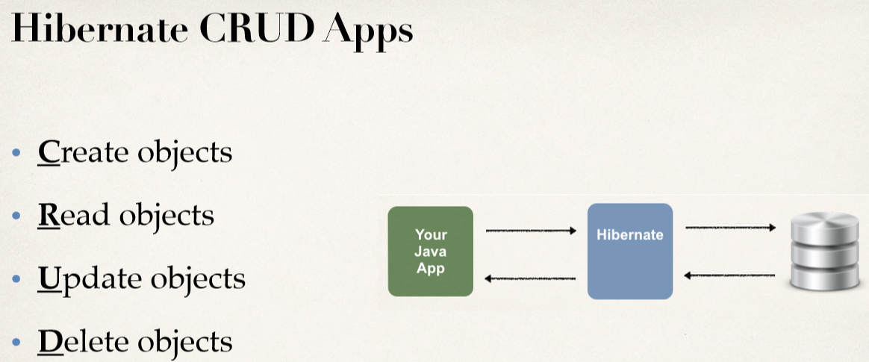

Slide 8
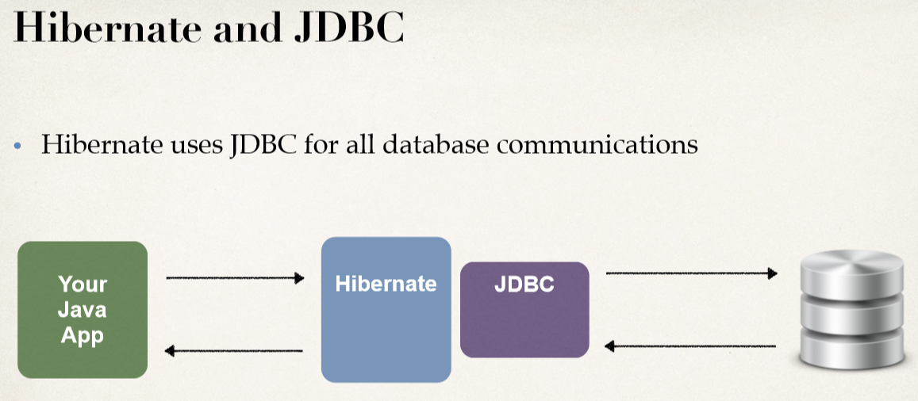

Slide 9
SET UP YOUR ENVIRONMENT
Must Have Java Development Kit (JDK)
You Must Have the Java Development Kit (JDK) Installed
Required Software
To Build Hibernate Applications, you need the following:
Java Integrated Development Environment (IDE)
Database Server
Hibernate JAR ﬁles and JDBC Driver

Slide 10
Setup Hibernate in Eclipse
To Do List
1. Create Eclipse Project
2. Download Hibernate Files
3. Download MySQL JDBC Driver
4. Add JAR ﬁles to Eclipse Project … Build Path

Slide 11
Hibernate Dev Process
To Do List
1. Add Hibernate Conﬁguration ﬁle
2. Annotate Java Class
3. Develop Java Code to perform database operations

Slide 12
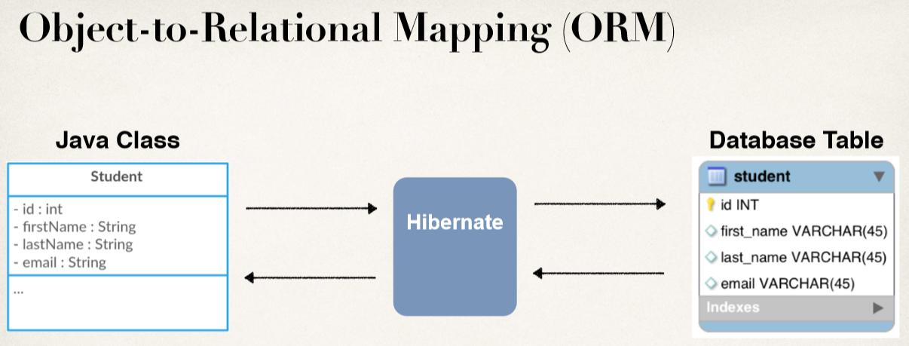
Annotate Java Class
Hibernate Dev Process - To Do List
1. Add Hibernate Conﬁguration ﬁle
2. Annotate Java Class
3. Develop Java Code to perform database operations

Slide 13
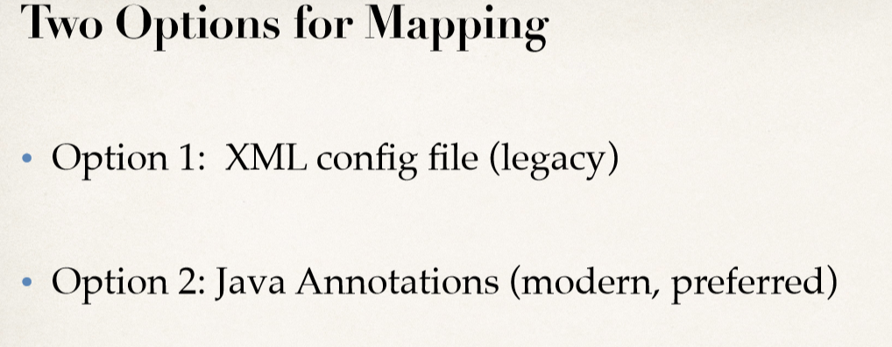

Slide 14
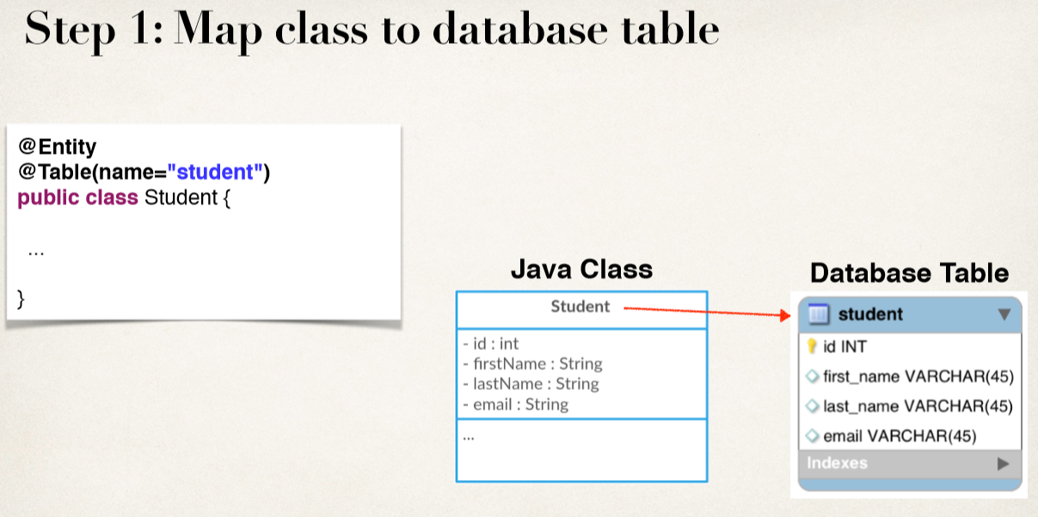
Java Annotations
• Step 1: Map class to database table
• Step 2: Map ﬁelds to database columns

Slide 15
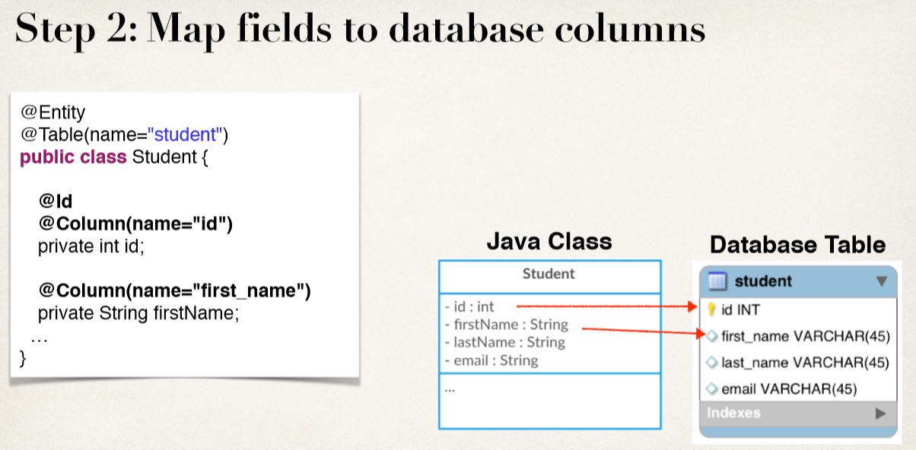

Slide 16
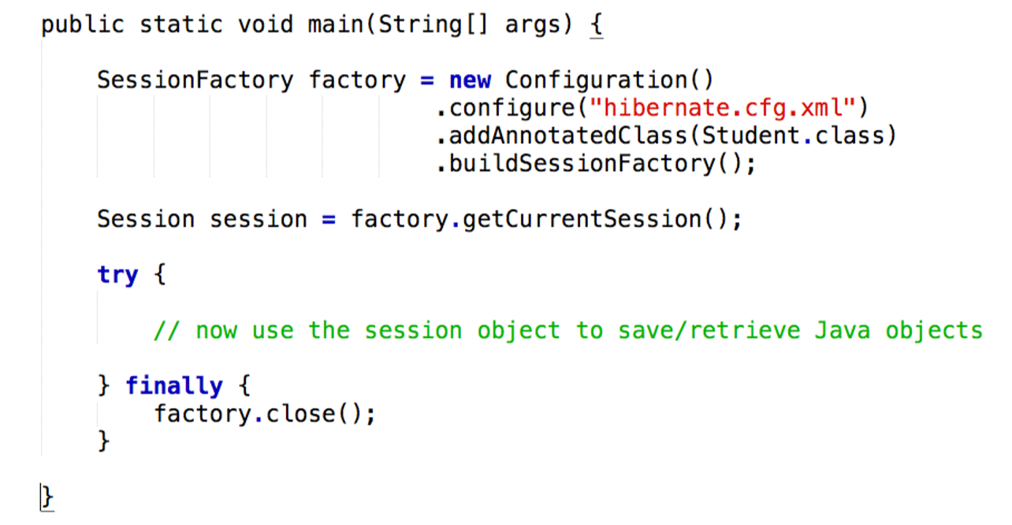
Save a Java Object

Slide 17
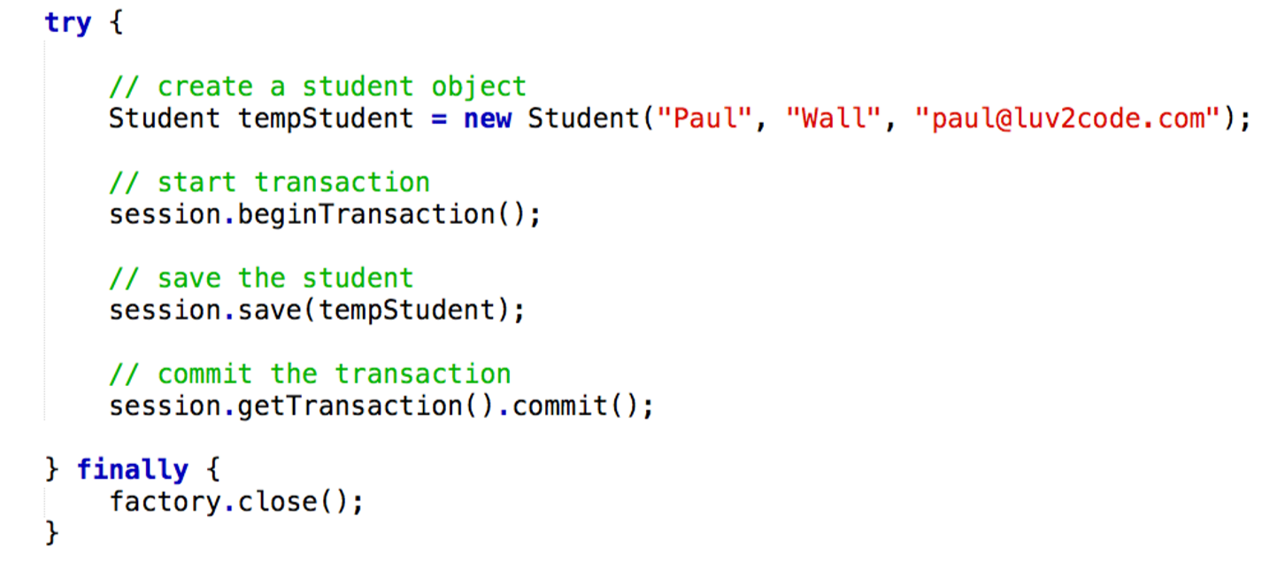

Slide 18
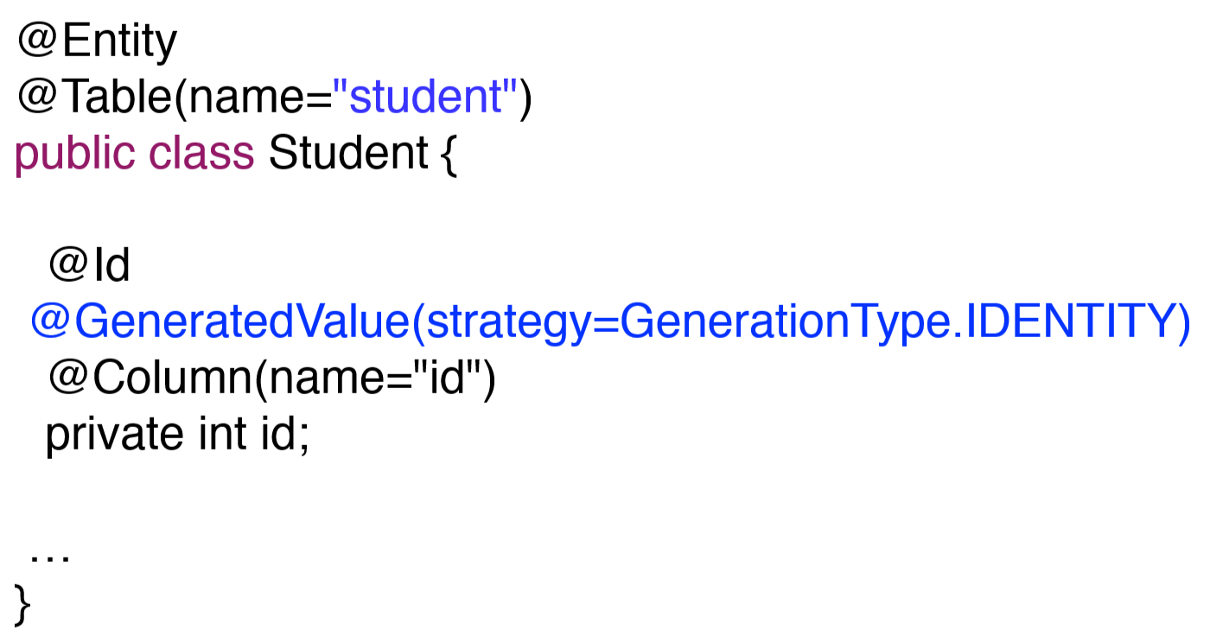
Primary Key:
Uniquely identifies each row in a table Must be a unique value Cannot contain NULL values

Slide 19
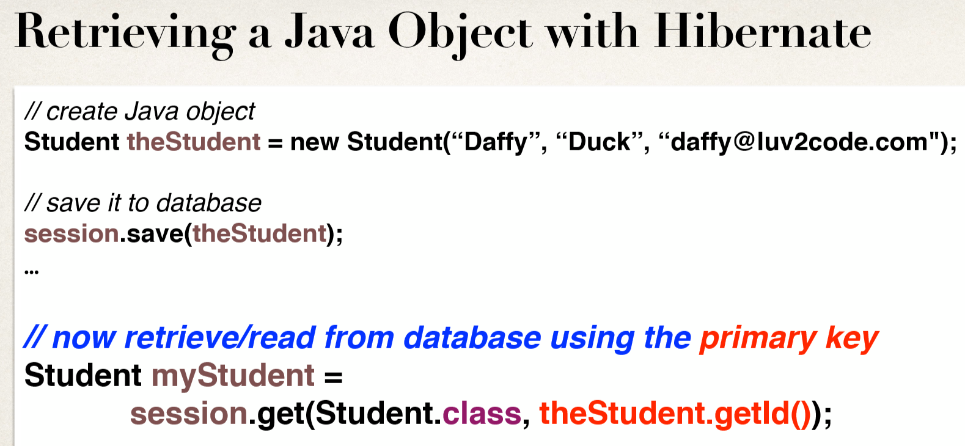
Retrieving an Object

Slide 20
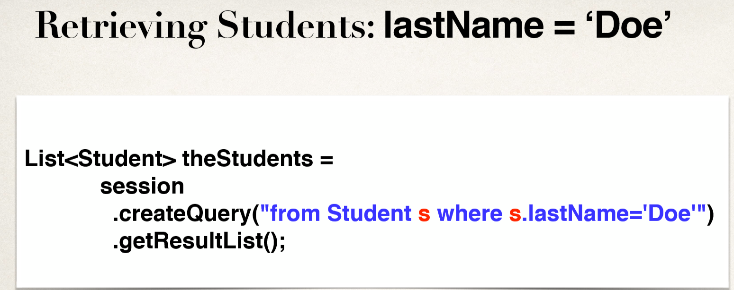
Querying Objects

Slide 21
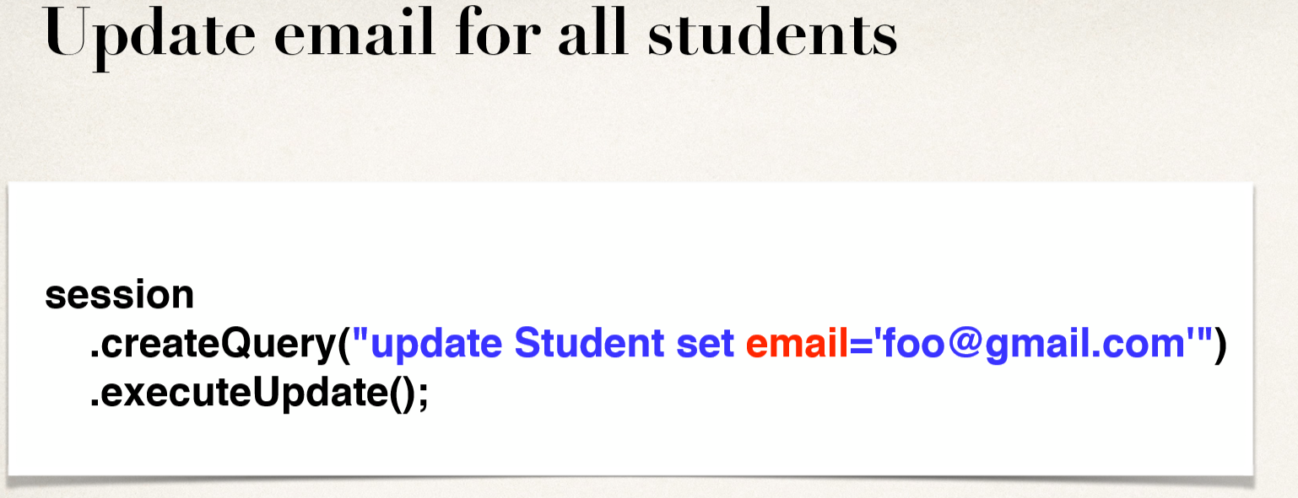
Updating Object(s)

Slide 22
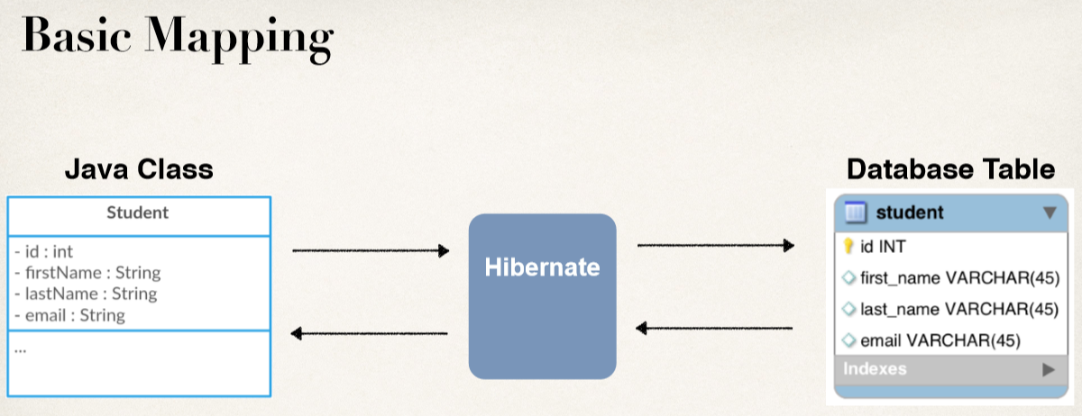
Hibernate Advanced Mappings

Slide 23
Advanced Mappings • In the database, you most likely will have • Multiple Tables • Relationships between Tables
• Need to model this with Hibernate
Advanced Mappings • One-to-One
• One-to-Many, Many-to-One
• Many-to-Many

Slide 24
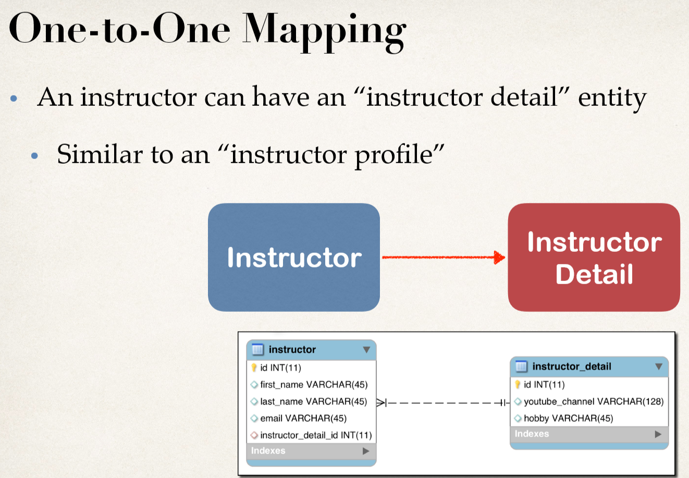

Slide 25
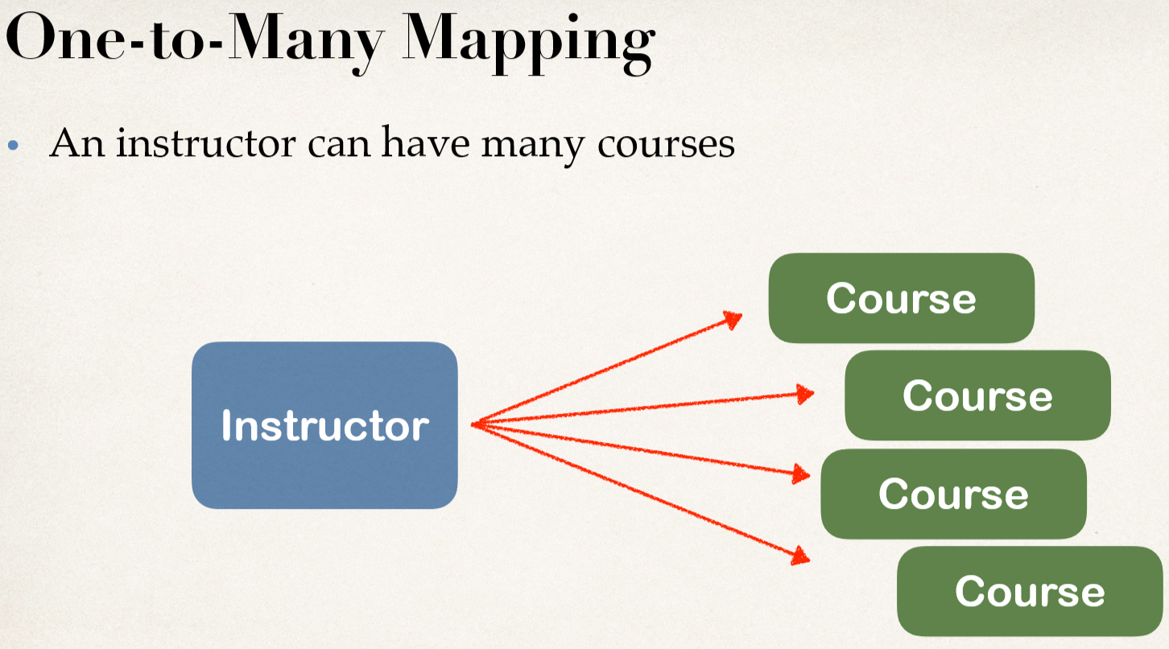

Slide 26
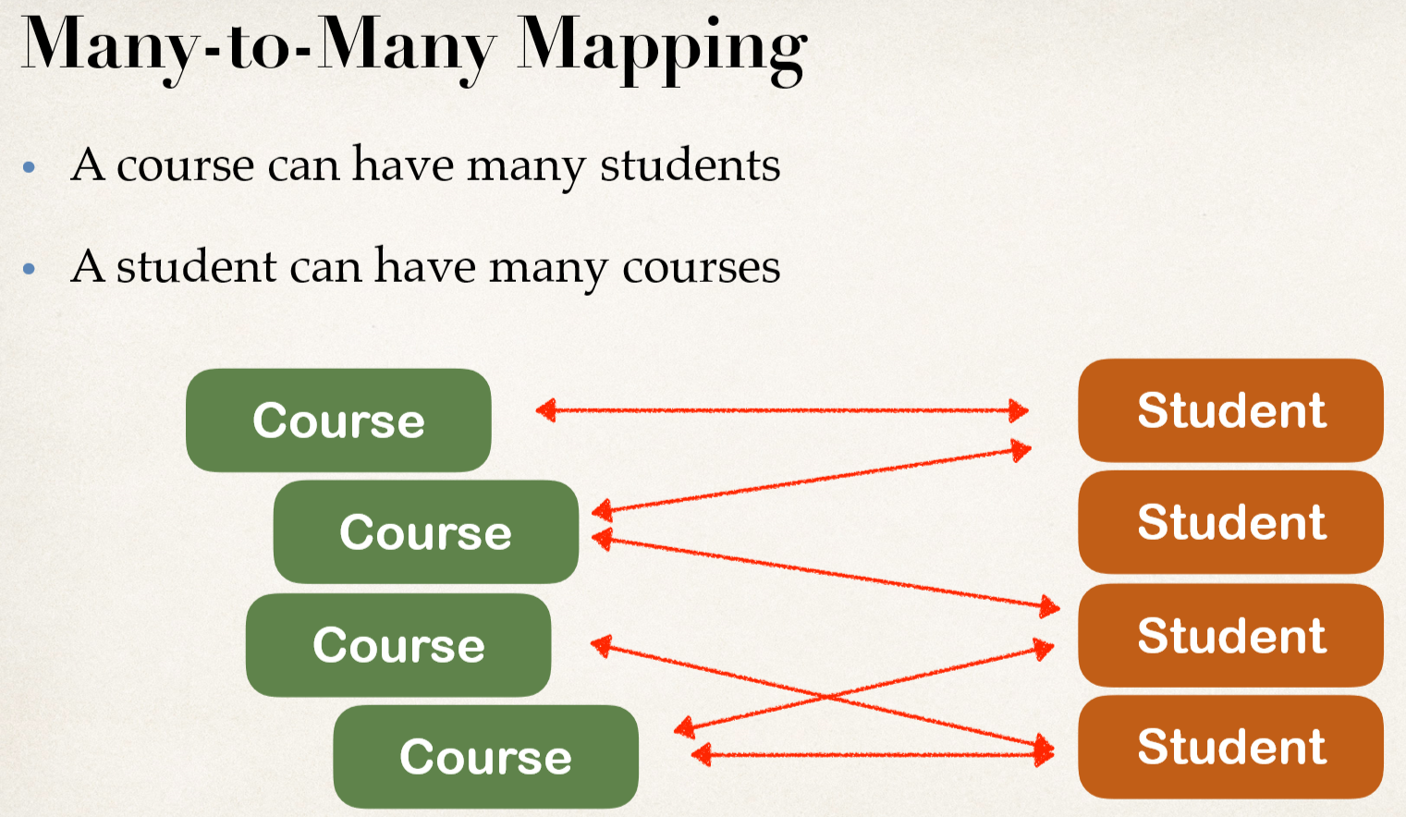

Slide 27
Important Database Concepts
• Primary key and foreign key
• Cascade
Primary Key and Foreign Key
• Primary key: identify a unique row in a table
Foreign key:
• Link tables together
• a ﬁeld in one table that refers to primary key in another table

Slide 28
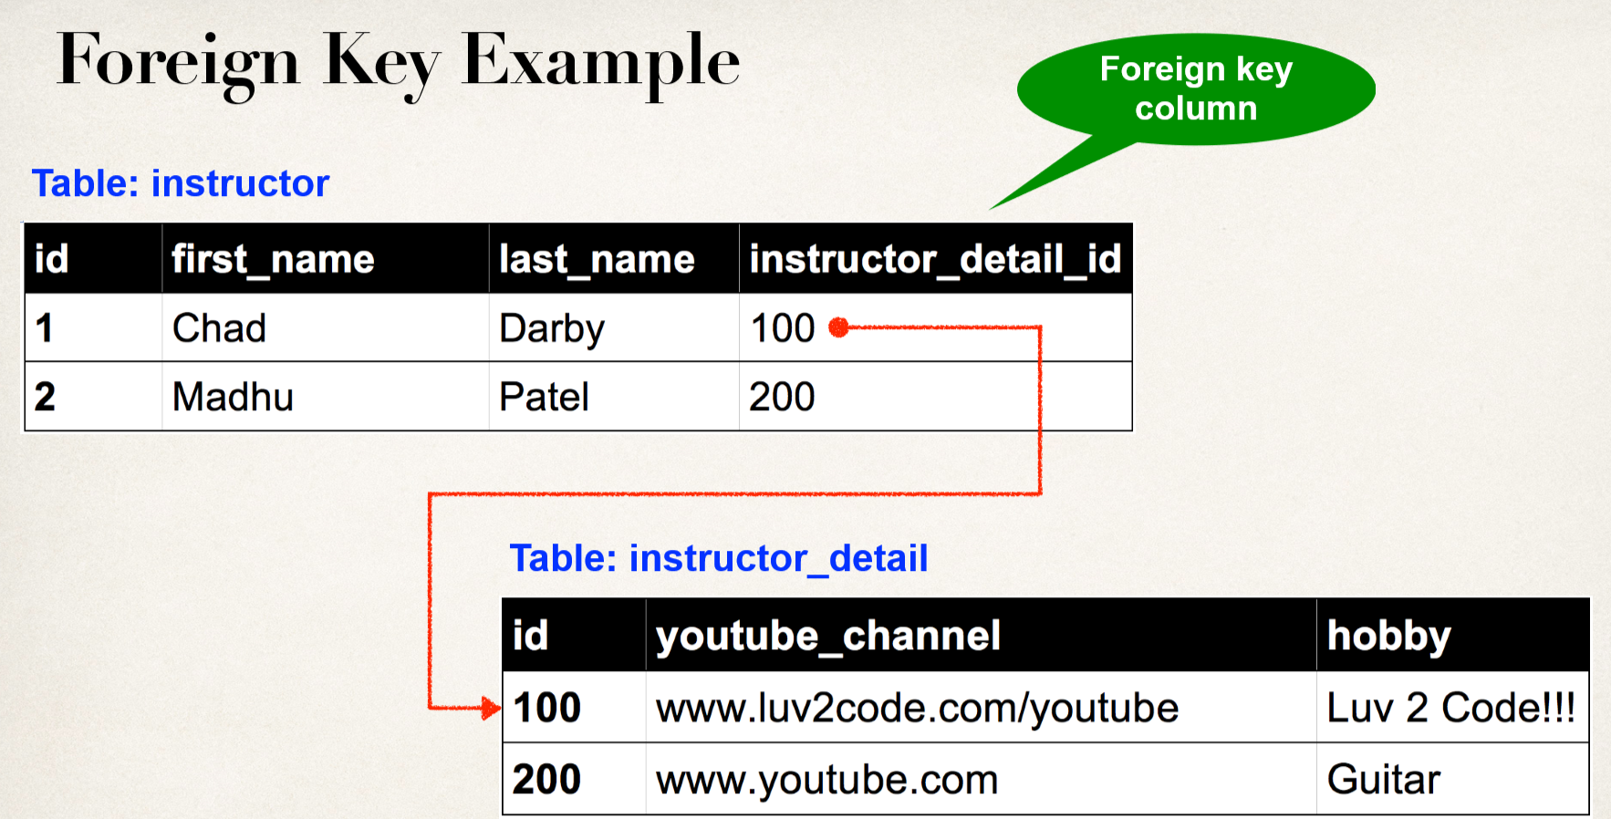

Slide 29
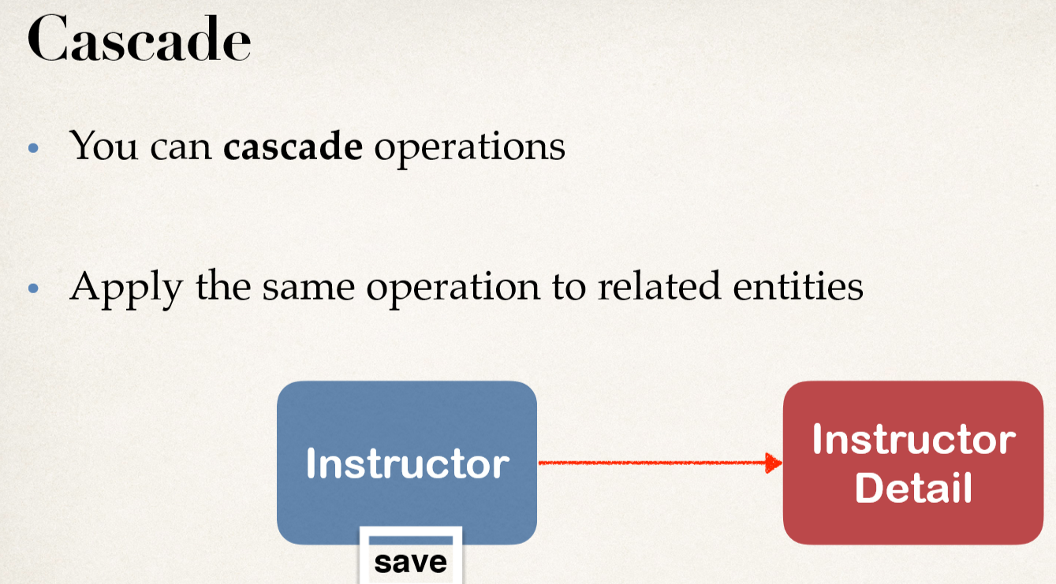

Slide 30
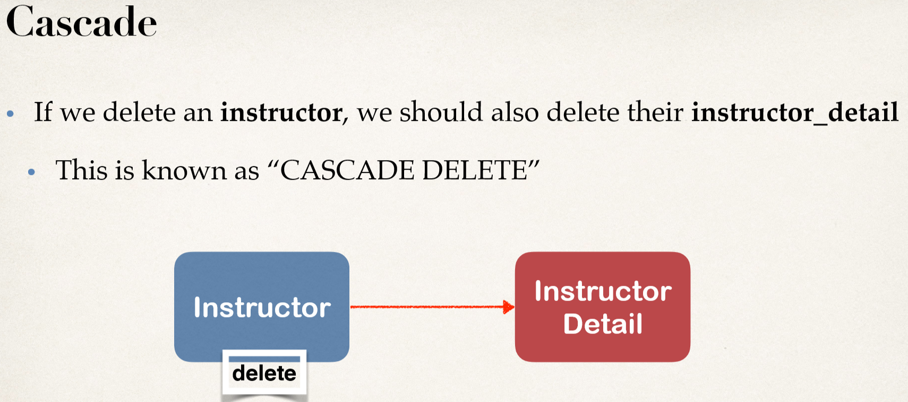

Slide 31
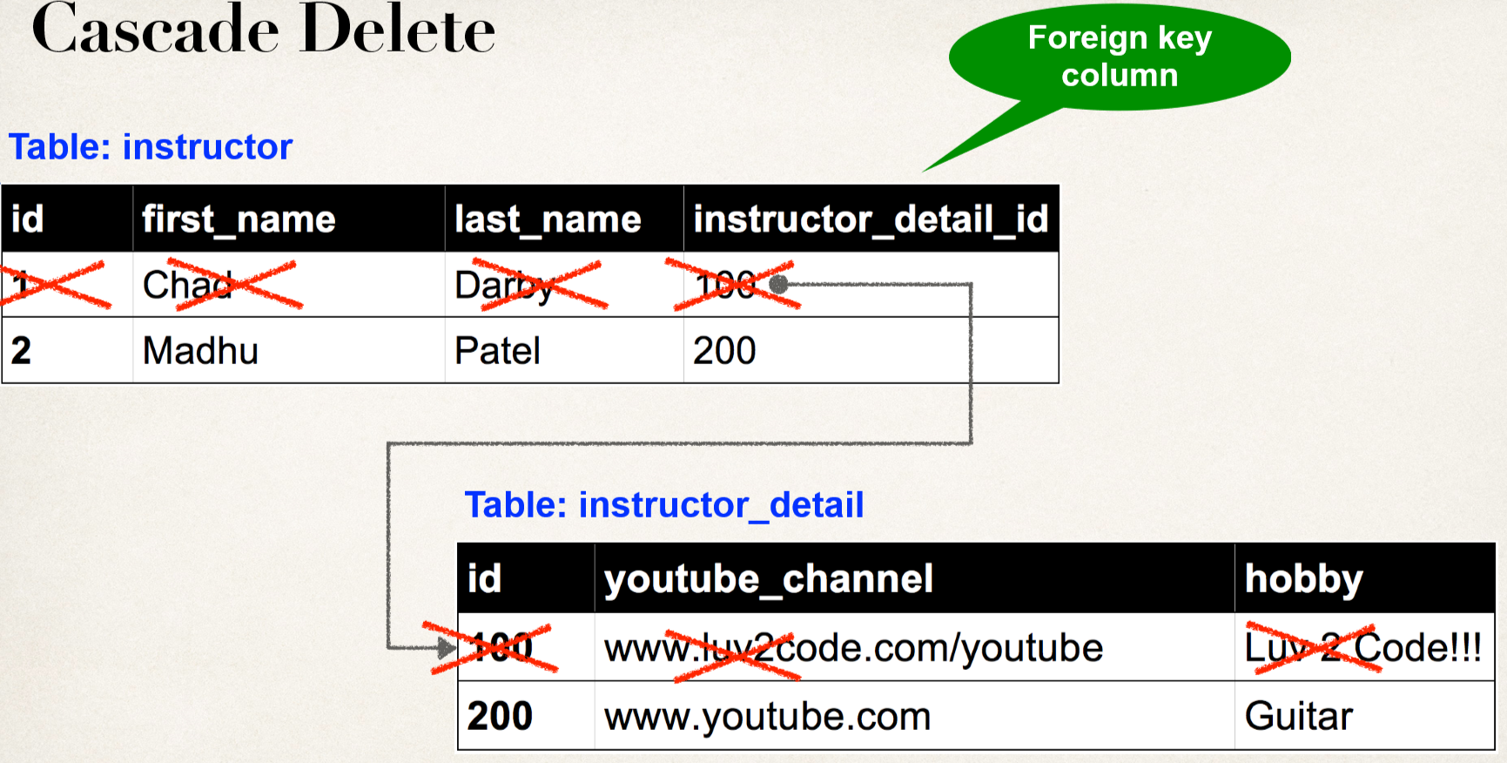

Slide 32
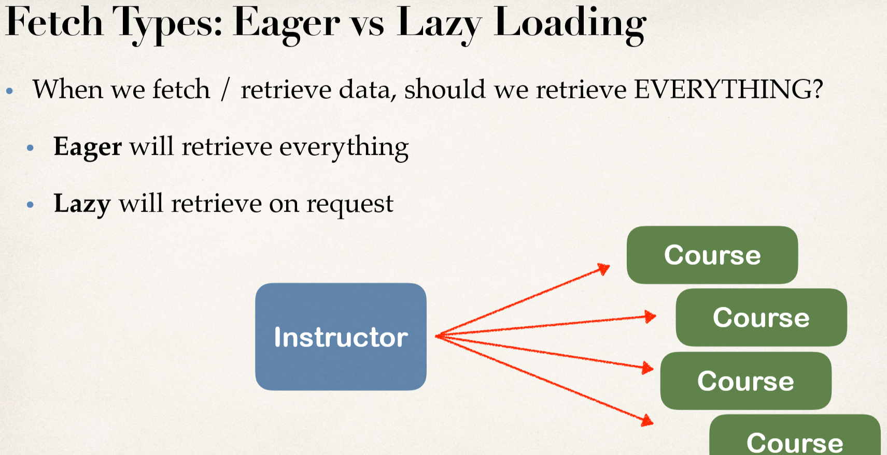

Slide 33
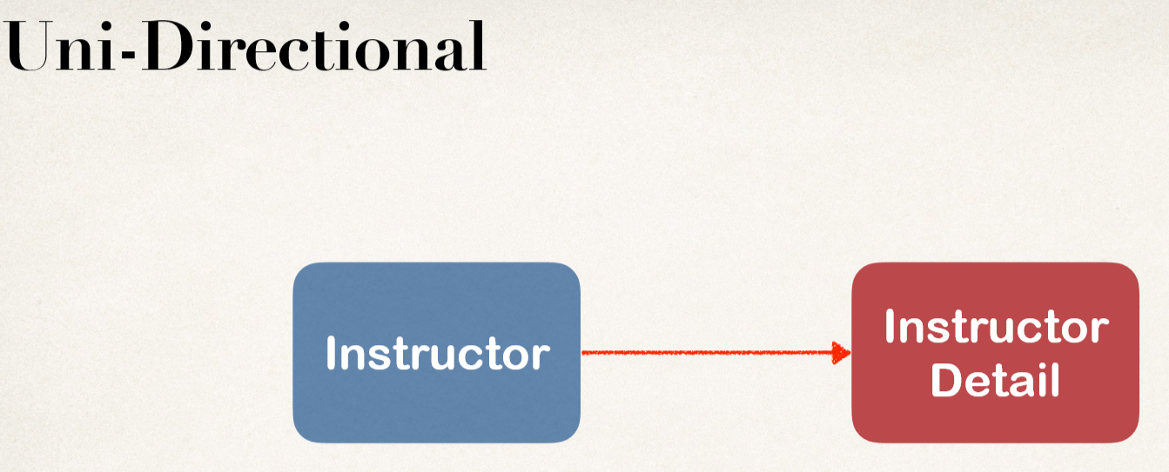

Slide 34
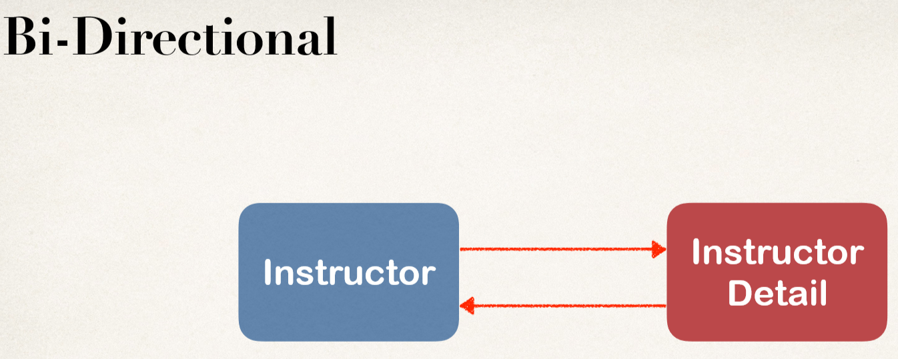

Slide 35
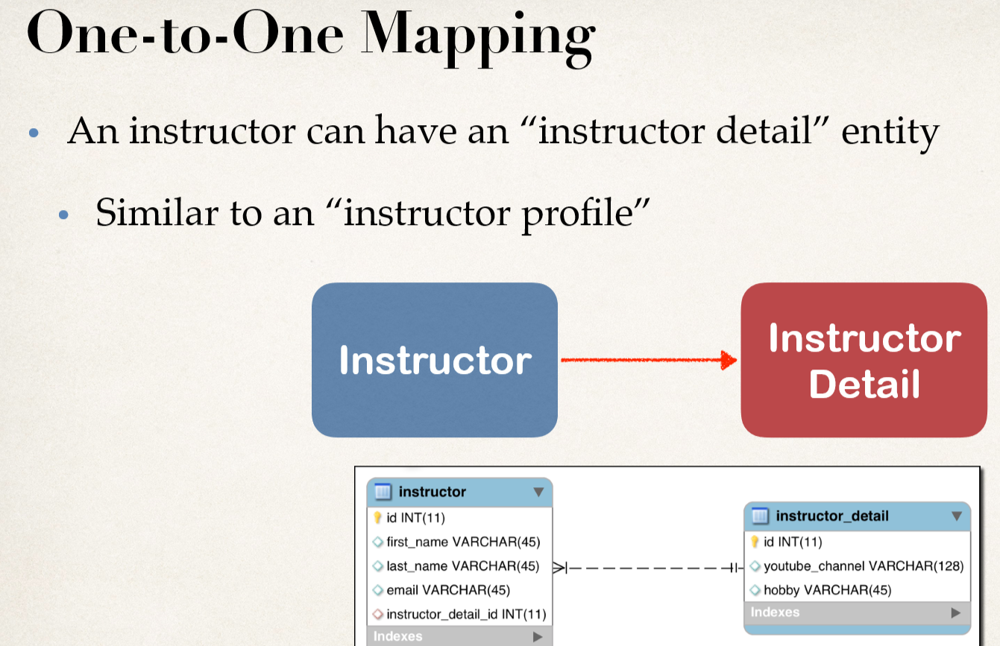

Slide 36
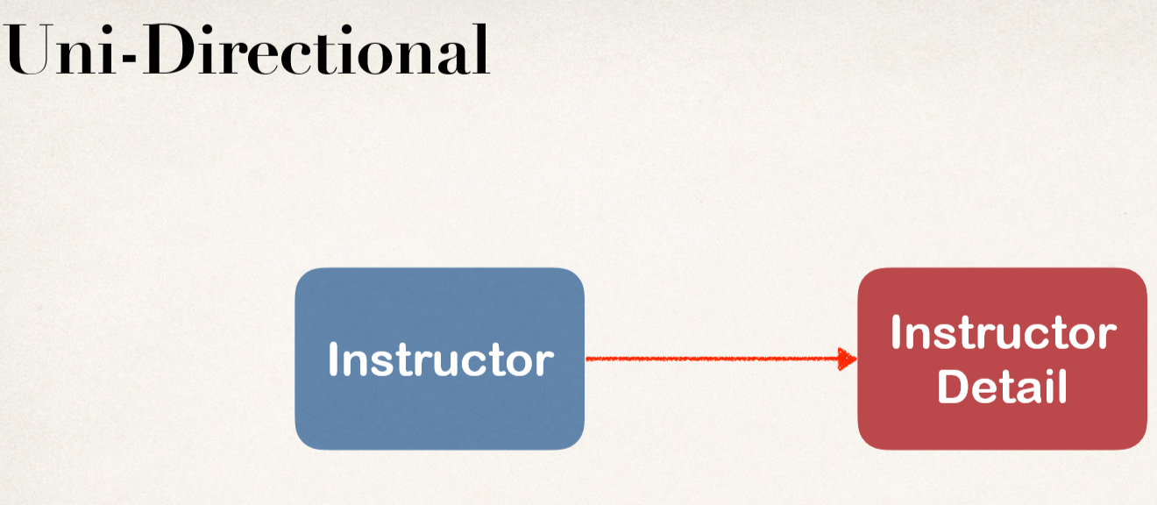

Slide 37
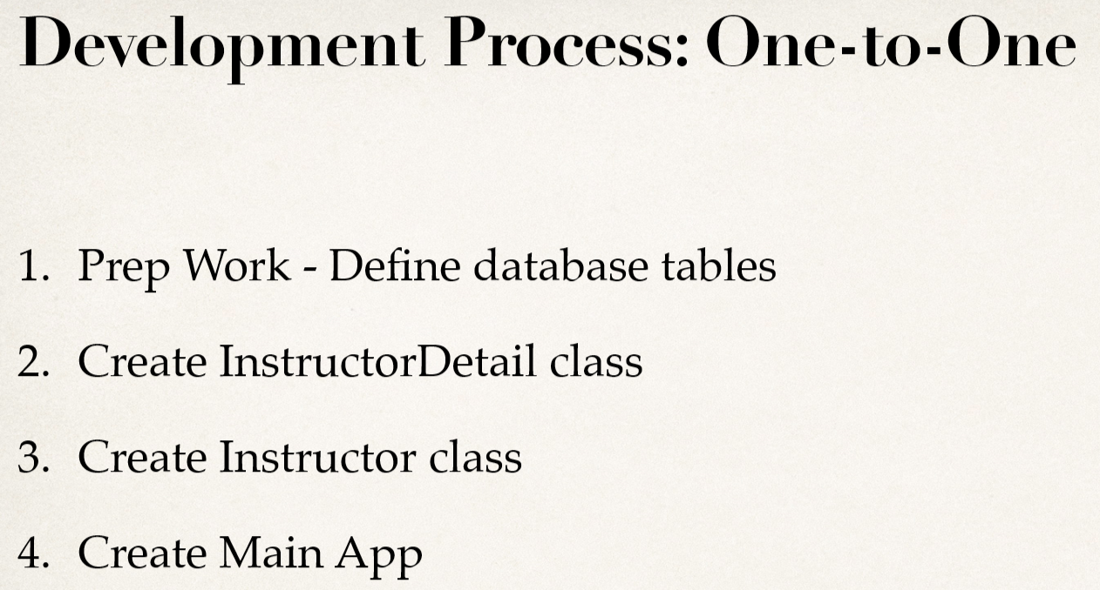

Slide 38
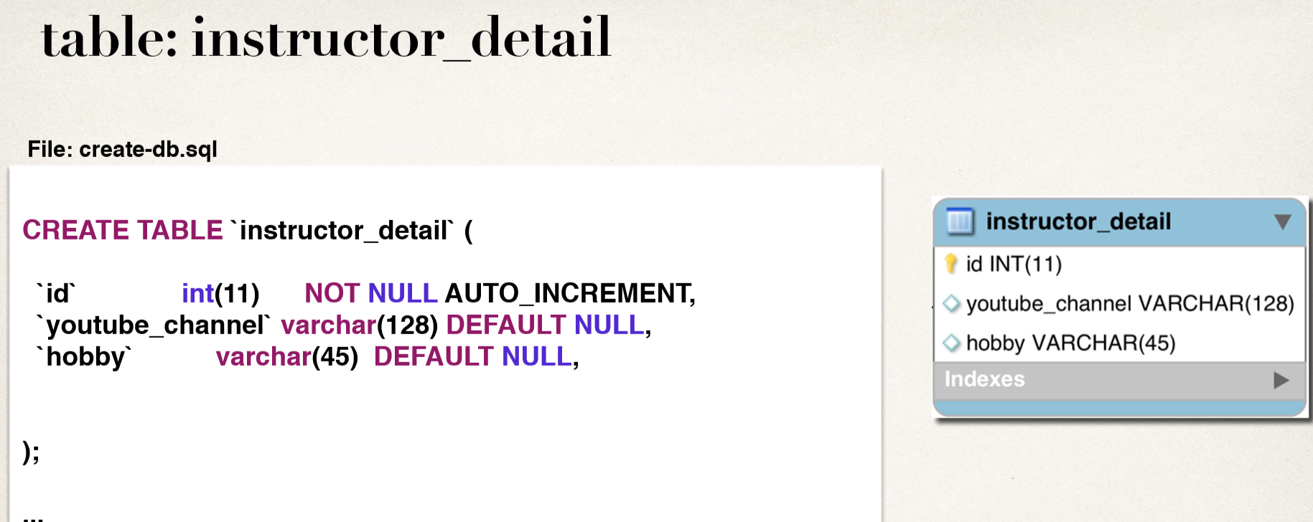

Slide 39
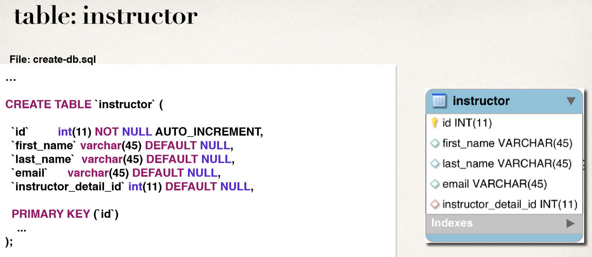

Slide 40
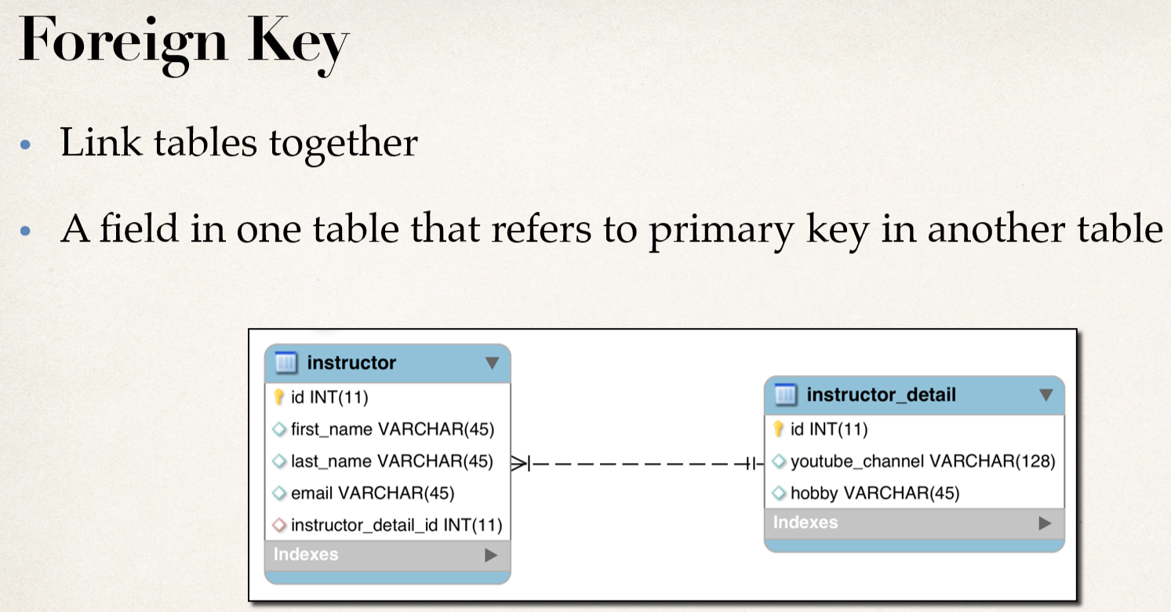

Slide 41
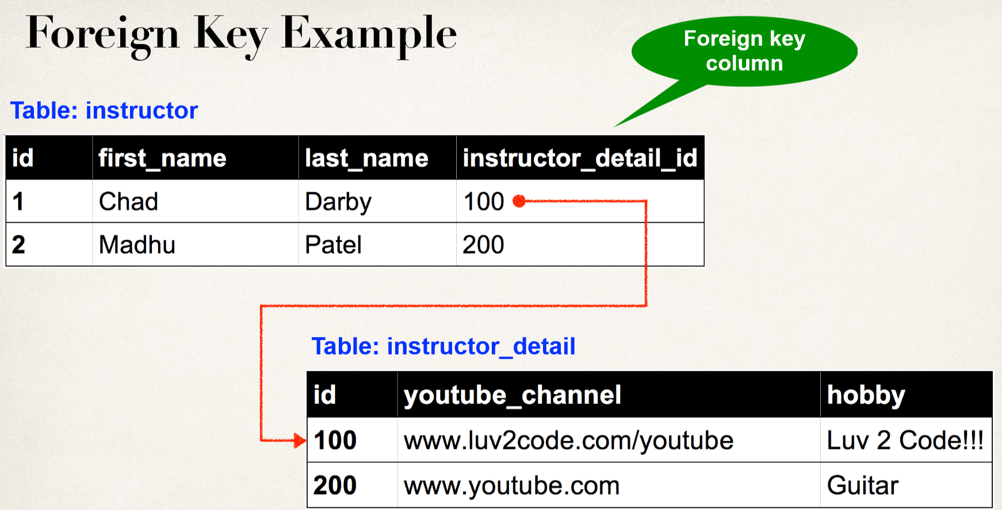

Slide 42
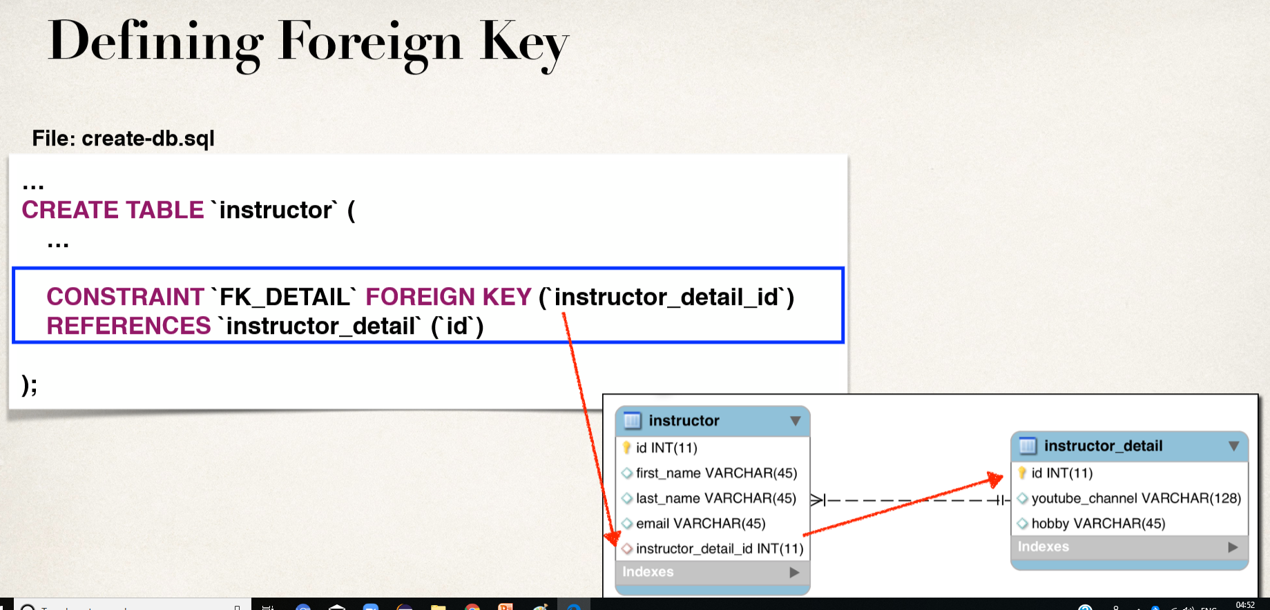

Slide 43
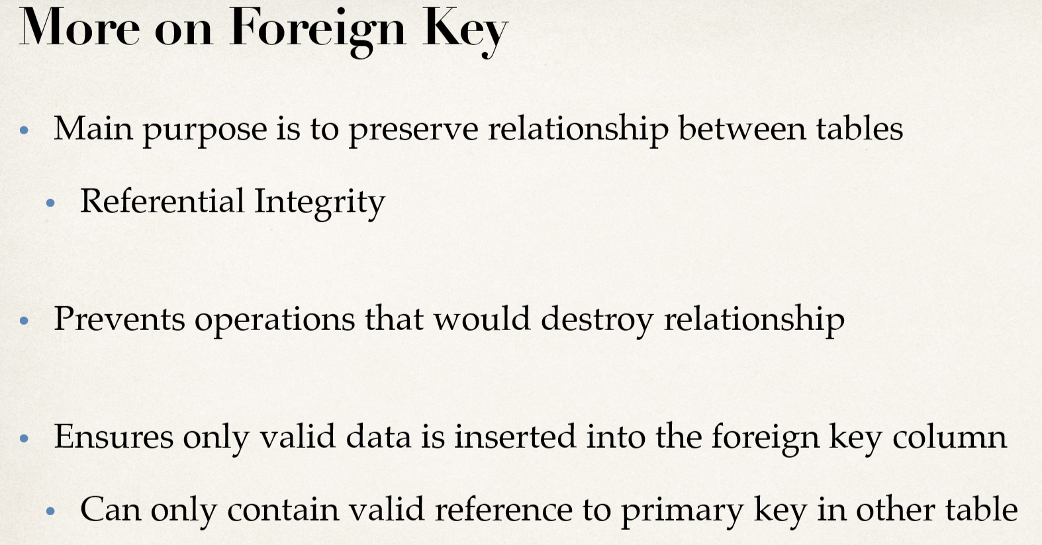

Slide 44
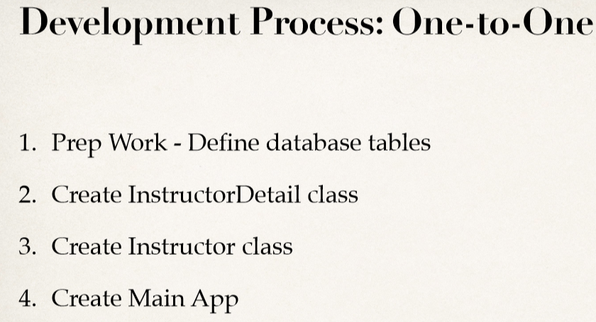

Slide 45
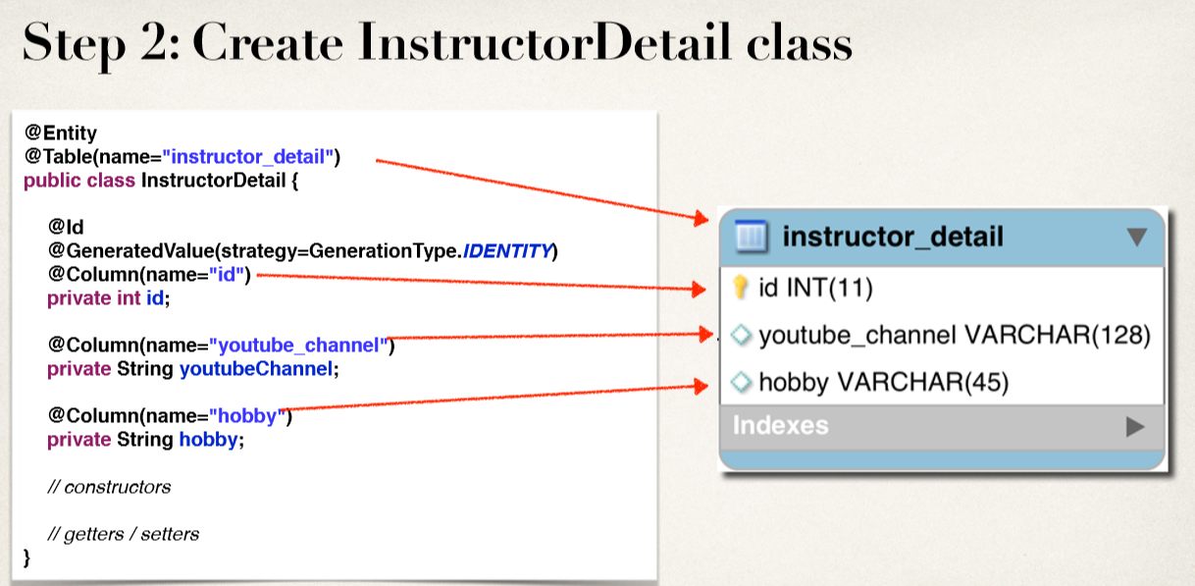

Slide 46
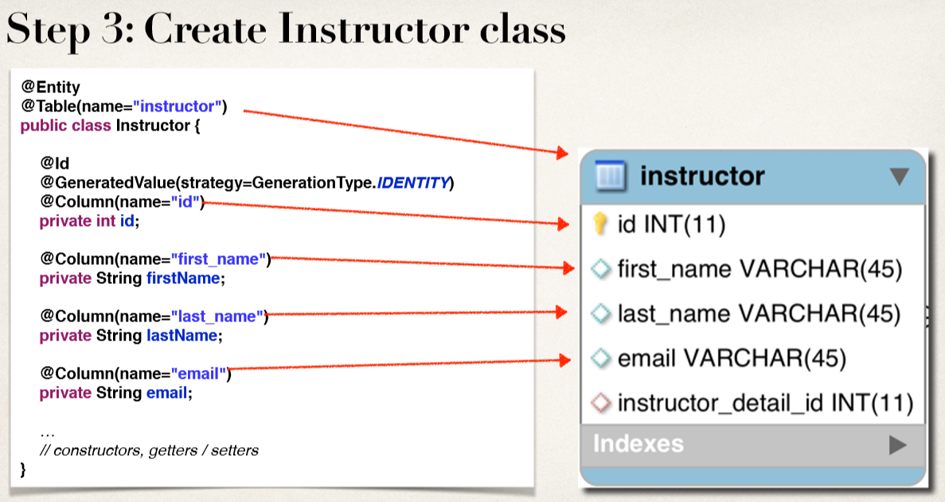

Slide 47
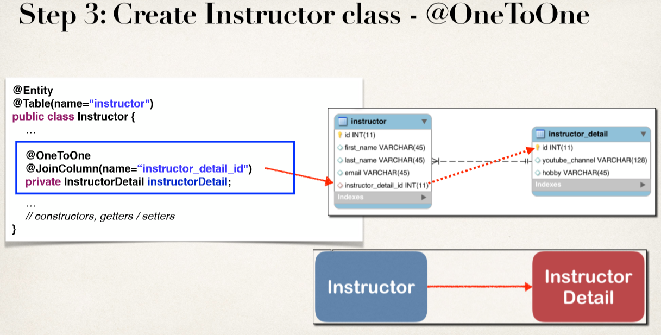

Slide 48
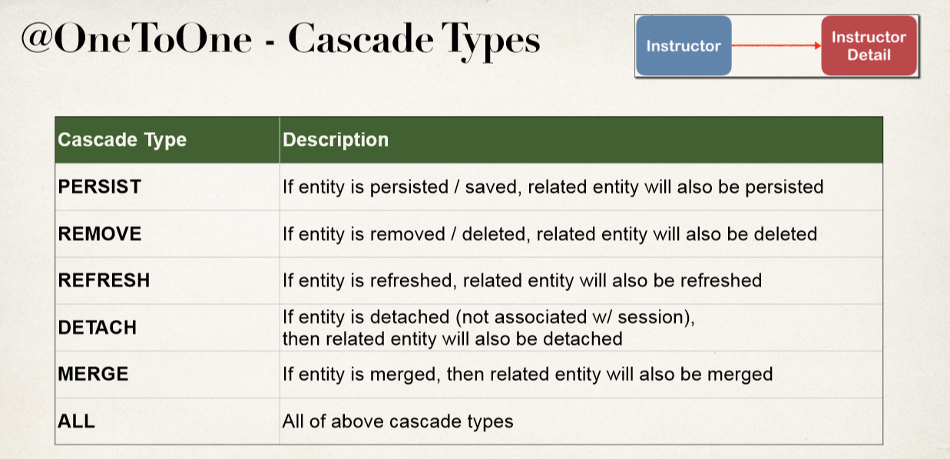

Slide 49
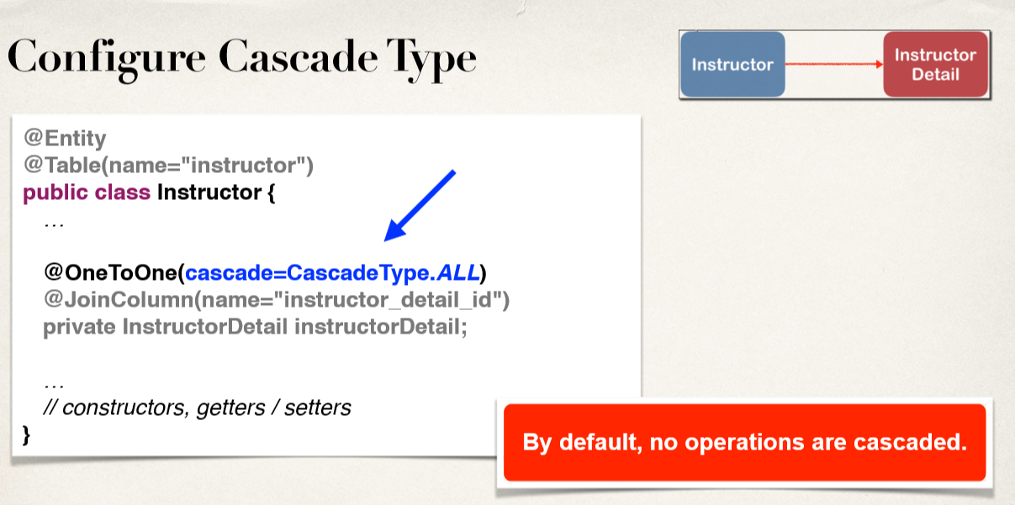

Slide 50
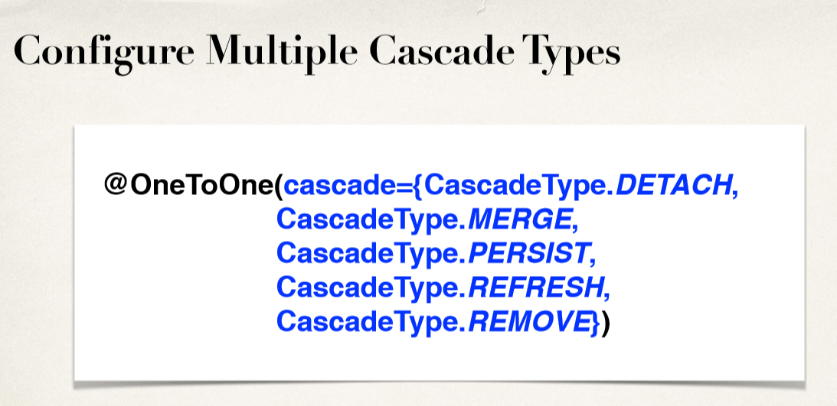

Slide 51
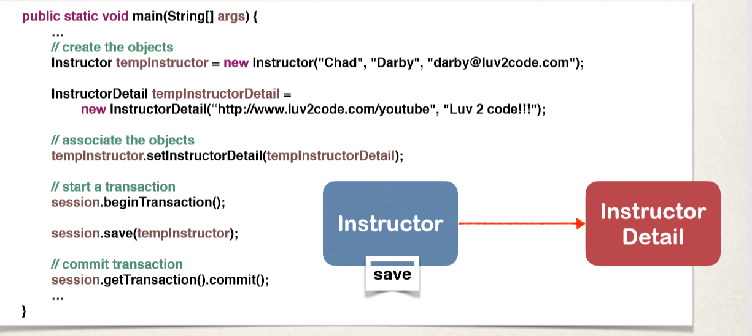

Slide 52
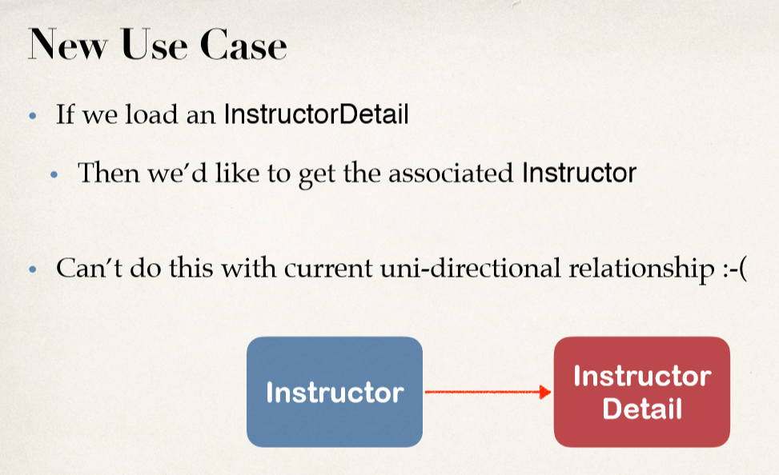
Hibernate One-to-One Bi-Directional

Slide 53
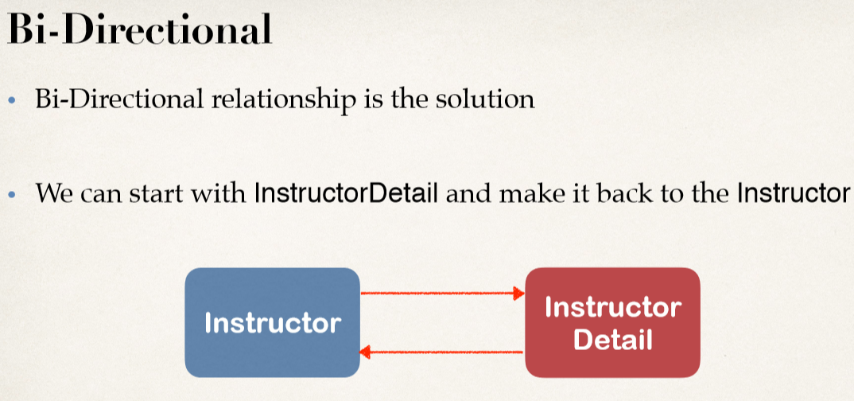

Slide 54
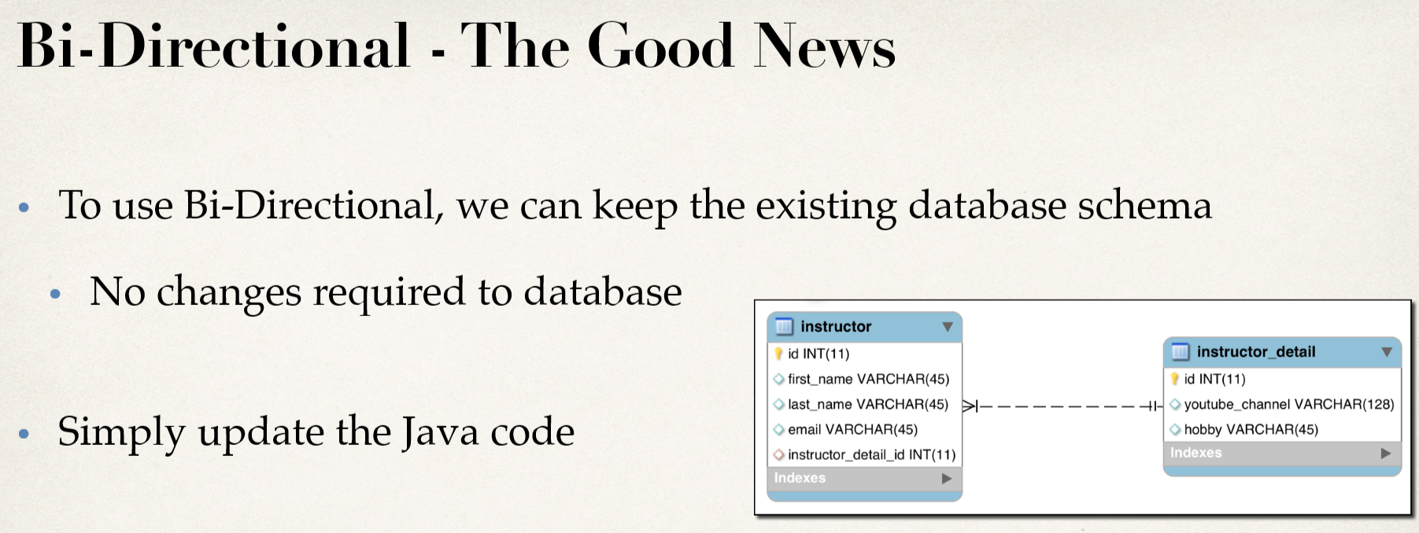

Slide 55
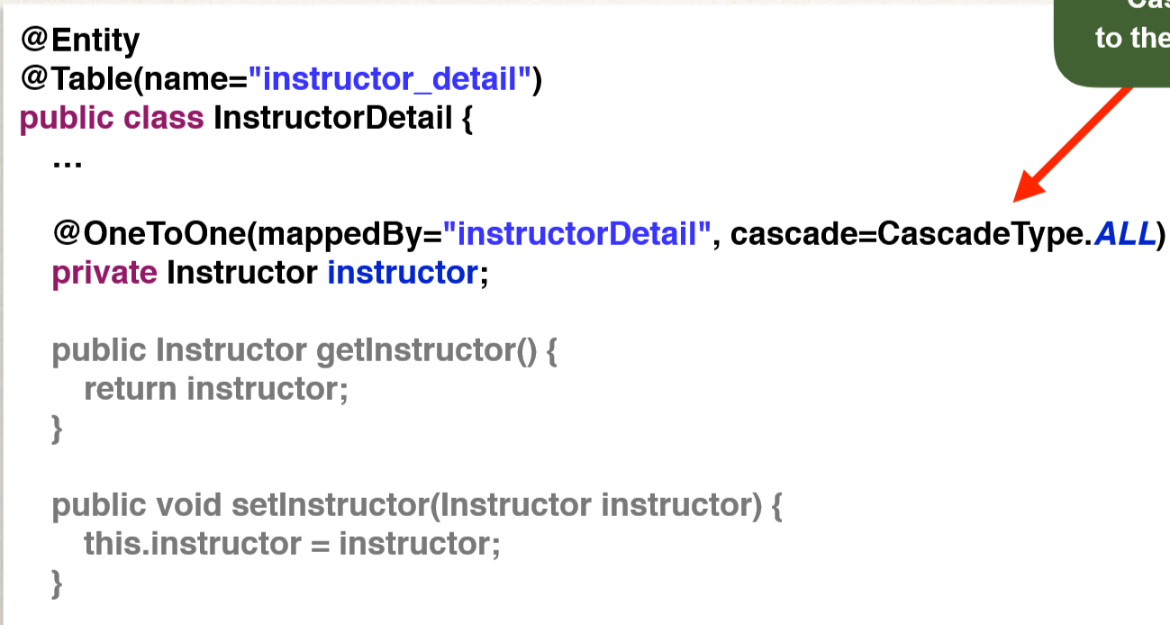

Slide 56


Slide 57


Slide 58

Hibernate One-to-Many Bi-Directional

Slide 59


Slide 60


Slide 61

Development Process: One-to-Many

Slide 62


Slide 63


Slide 64


Slide 65


Slide 66


Slide 67


Slide 68


Slide 69
Fetch Types: Eager vs Lazy
• When we fetch / retrieve data, should we retrieve EVERYTHING? • Eager will retrieve everything • Lazy will retrieve on request

Slide 70


Slide 71


Slide 72


Slide 73


Slide 74


Slide 75


Slide 76


Slide 77


Slide 78


Slide 79

Hibernate One-to-Many Uni-Directional

Slide 80


Slide 81


Slide 82


Slide 83


Slide 84


Slide 85


Slide 86


Slide 87


Slide 88


Slide 89


Slide 90


Slide 91

Hibernate Many-to-Many

Slide 92


Slide 93


Slide 94


Slide 95


Slide 96

Development Process: Many-to-Many

Slide 97


Slide 98


Slide 99


Slide 100


Slide 101


Slide 102


Slide 103


Slide 104


Slide 105


